Slide 1
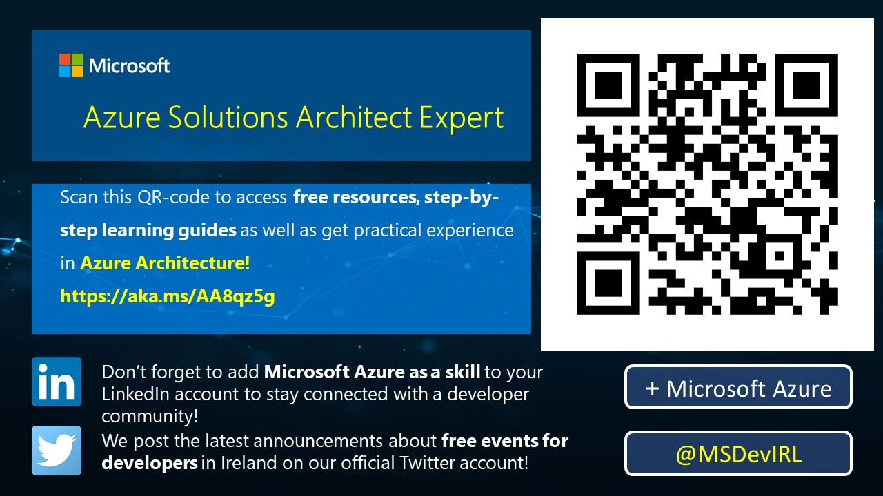

Slide 2
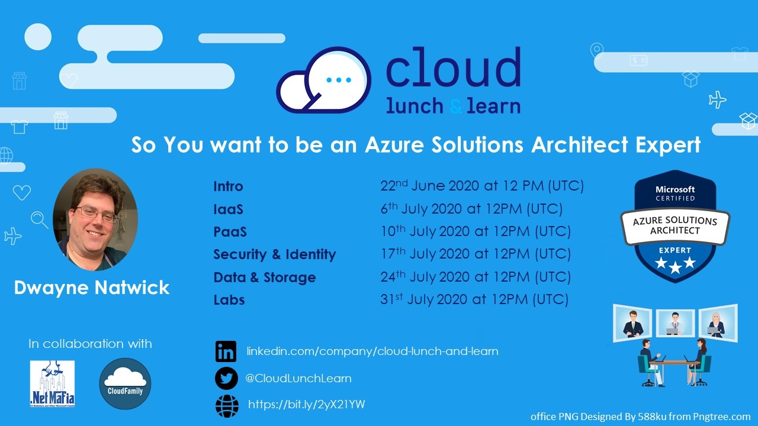

Slide 3
SO YOU WANT TO BE AN AZURE ARCHITECT EXPERT
Steps to take to gain this valuable certification
Notes:
Thank you for joining this Cloud lunch and learn session. I’m going to speak to you today about Azure Certifications and Becoming a certified Azure Developer Associate

Slide 4




ABOUT THE AUTHOR
I am an author, trainer, and product manager with over 30 years of experience in the IT industry. I am a CISSP, PMP, and certified in multiple Azure and M365 roles, including Solution Architect Expert, Administrator Associate, and Security Engineer Associate.
In addition to creating curriculum, training, public speaking, and blog writing, I am also a Microsoft Certified Trainer and Regional Lead.
You can find me on social media at:
https://captainhyperscaler.com
http://linkedin.com/in/dnatwick
@DwayneNcloud
Dwayne Natwick
Sr. Cloud Training Architect
CISSP, PMP, 9x Azure/M365 Certified
MCT Regional Lead
Notes:
My name is Dwayne Natwick and I will be your instructor for this course. I am an author, trainer, and product manager that has been in the IT industry for over 30 years. I currently have multiple Azure and 365 role-based certifications along with my CISSP and PMP.​
​
I am a Microsoft Certified Trainer and a Regional Lead for the program. You can find me active on social media at the links provided on the slide.​

Slide 5

TOPICS
Building a certification roadmap
Exam preparation
Learning resources
Azure Solutions Architect Expert certification objectives and key areas
Next steps
Notes:
This discussion is going to provide you with guidance on determining a certification path and building your certification roadmap, preparing for an exam, including some learning resources to use in your preparation.
We will then go through a high level overview of the Azure Developer Associate exam, and the objectives and key areas that are covered on this exam.
We will finish up with the next steps to take in building your path to passing the Azure Developer Associate exam.

Slide 6
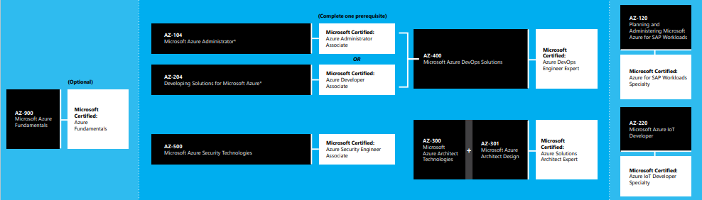
BUILDING A CERTIFICATION ROADMAP
Ask yourself these questions:
  What role do you currently play in the cloud?
  Where do I want my role to go?
  What does my career or role look like in the next year?
  What does my career or role look like five years from now?
  Do I want change my role in the next year or five years?
https://query.prod.cms.rt.microsoft.com/cms/api/am/binary/RE2PjDI
Notes:
When planning to jump into cloud training and certifications, it is important to determine the direction that you want to go by creating a roadmap.
There are certain questions to ask to help you to build your roadmap.
It is good to think about the present, 1 year from now, and 5 years from now when building your roadmap. Think of your roadmap in terms of planning out the path to make you happy in your career now and in the future. If you do not see yourself in your current role in five years. You may be an infrastructure engineer today, but want to be more involved in security or development. Building your roadmap to get the hands-on experience and certifications in this area will help you to get there.
The link on the slide provides the entire learning path guide for all role based exams and certifications.

Slide 7
LEARNING RESOURCES
Microsoft Learn – Free resource. Learning paths available for many of the exam paths and objective areas
  https://docs.microsoft.com/en-us/learn/certifications/exams/az-300?wt.mc_id=learningredirect_certs-web-wwl
  https://docs.microsoft.com/en-us/learn/certifications/exams/az-301?wt.mc_id=learningredirect_certs-web-wwl
Microsoft docs
Microsoft hands-on labs
On-demand courseware
Practice exams
Blog sites from community members
https://build5nines.com/free-oss-exam-self-assessment-tool/
Notes:
To continue from the last slide, Microsoft Learn is a great resource to start your exam preparation. This is a FREE resource and many of the Azure and 365 exams have learning paths that are already created that cover the exam objectives. This is the case with the Azure Developer Associate exam.
Microsoft docs is a great way to read through the specific directions and capabilities of each service within Azure. These docs include getting started information, and even tutorials on the service that can be stepped through in your own subscription for hands-on learning.
Microsoft also has some hands-on lab resources for multiple focus areas. In addition, some of the Microsoft Learn modules even have sandbox environments and lab exercises built into them.
Other resources include on-demand courseware from learning sites, many of which have discounts currently and continually for individual courses and memberships.
Social media is helpful to find community members and MVPs that have sites where they post articles and links to there own github repos with study guides.

Slide 8
AZURE SOLUTIONS ARCHITECT EXPERT OBJECTIVES AND KEY AREAS
Azure Solutions Architect Expert certification objectives were adjusted earlier this year
Exam numbers will be changing
  AZ-300 retires on September 30, 2020, replaced by AZ-303 (beta June 29)
  AZ-301 retires on September 30, 2020, replaced by AZ-304 (beta June 29)
Passing both exams will award you with the Azure Solution Architect Expert certification (good for two years)
Objective areas by exam
  AZ-300/AZ-303: https://query.prod.cms.rt.microsoft.com/cms/api/am/binary/RE3VzwB
  AZ-301/AZ-304: https://query.prod.cms.rt.microsoft.com/cms/api/am/binary/RE3VEHD
Notes:
Let’s move into the specifics of the Azure Developer Associate exam.
The objectives to this exam were adjusted and updated earlier this year and this has led to Microsoft changing the exam number from AZ-203 to AZ-204. Both of these exams are currently active and you will obtain the Azure Developer Associate certification. The 203 exam will retire on August 31 of this year, and then the 204 will be the one an only exam for this certification.
Associate and Expert exams are valid for two years.
The objectives covered on this exam are listed here and will be covered in the next few slides.

Slide 9
MICROSOFT AZURE ARCHITECT TECHNOLOGIES (300/303 EXAM)
Objective areas:
  Deploy and configure infrastructure (40-45%)
  Implement workloads and security (25-30%)
  Create and deploy apps (5-10%)
  Implement authentication and secure data (5-10%)
  Develop for the cloud and for Azure storage (15-20%)
Very closely aligned to the AZ-104 exam
Long exam, one of the few that could take up the entire time
Notes:
Connect to and consume Azure services and third party services is the next objective. Like the previous objective, you can expect around 15 questions on these objective areas.
If you add the weighted percentages of these first two objective areas, you can see that these make up 50-60% of the exam.
The key areas to be sure to understand here is how to configure and setup Azure Logic Apps, Azure Event Grid, Azure Notification hubs, Azure Event Hubs, Azure Services bus, and Azure Storage Queues. As well as API management for third party services.

Slide 10
MICROSOFT AZURE ARCHITECT DESIGN (301/304 EXAM)
Objective areas:
  Determine workload requirements (10-15%)
  Design for identity and security (25-30%)
  Design a data platform solution (15-20%)
  Design a business continuity strategy (15-20%)
  Design for deployment, migration, and integration (10-15%)
  Design an infrastructure strategy (15-20%)
More design focus with case studies
Databases
Azure Site Recovery
Azure Migrate
Notes:
Connect to and consume Azure services and third party services is the next objective. Like the previous objective, you can expect around 15 questions on these objective areas.
If you add the weighted percentages of these first two objective areas, you can see that these make up 50-60% of the exam.
The key areas to be sure to understand here is how to configure and setup Azure Logic Apps, Azure Event Grid, Azure Notification hubs, Azure Event Hubs, Azure Services bus, and Azure Storage Queues. As well as API management for third party services.

Slide 11
NEXT STEPS
Take your self assessment
Microsoft Learn
Microsoft Docs
Create an Azure account for hands-on
Reach out with any questions or additional guidance
Future sessions on specific objective areas (schedule on next slide)
Notes:
What should you do now.
I suggest that you start by downloading and taking the self assessment on the Azure Developer Associate exam.
Start to review the information in Microsoft docs, and take the Learning path in Microsoft Learn.
Create an Azure account for hands-on and also download Docker.
Feel free to reach out to me with any questions or additional guidance. If you would like specific objective areas to be covered in more detail, we may be able to provide sessions in the future with deeper dive into these objectives.

Slide 12
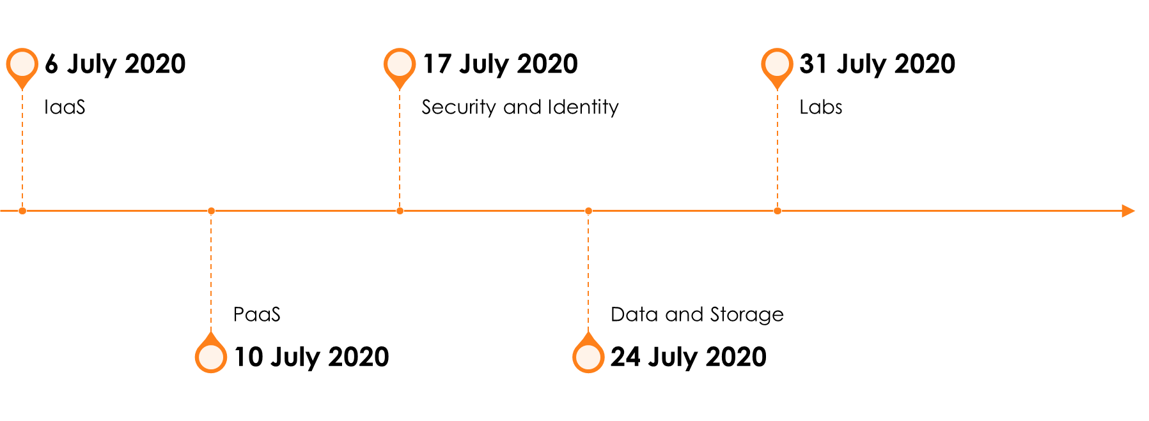
SO YOU WANT TO BE AN AZURE ARCHITECT EXPERT PREP SERIES

Slide 14
THANK YOU!
You can find me on social media at:
https://captainhyperscaler.com
http://linkedin.com/in/dnatwick
@DwayneNcloud
Notes:
Thank you for your time today. Feel free to reach out to me at any of the links on the screen.

